Slide 1
Arrays & Objects
Array Methods and Object Manipulation
JavaScript provides powerful tools to work with data
Arrays and Objects are the most used data structures
This presentation explains common array methods and object handling

Slide 2

Arrays
An array is a collection of multiple values
Values can be of any data type
Elements are stored in ordered sequence
Index starts from 0
Example:

Slide 3
Why Use Array Methods
Makes code shorter and cleaner
Avoids writing long loops
Improves readability and performance
Widely used in real-world applications

Slide 4

map() Method
Used to transform data
Returns a new array
Original array remains unchanged
Each element is processed one by one
Example:

Slide 5
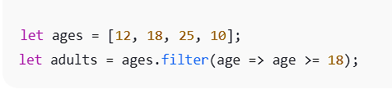
filter() Method
Used to select specific elements
Returns a new filtered array
Condition must return true or false
Example:

Slide 6

reduce() Method
Converts array into one single value
Used for sum, total, average, count
Uses an accumulator variable
Example:

Slide 7

forEach() Method
Executes a function for each element
Mainly used for display or logging
Does not return anything
Example:

Slide 8

some() Method
Checks if any one element satisfies condition
Stops execution once true is found
Returns true or false
Example:

Slide 9

every() Method
Checks if all elements satisfy condition
If one fails, returns false
Used for validation
Example:

Slide 10

find() Method
Returns the first matching value
Useful when searching objects or arrays
Returns undefined if not found
Example:

Slide 11

findIndex() Method
Returns the index number
Helps in update or delete operations
Returns -1 if element not found
Example:

Slide 12

Objects in JavaScript
Objects store data in key–value pairs
Keys are also called properties
Used to represent real-world data
Example:

Slide 13
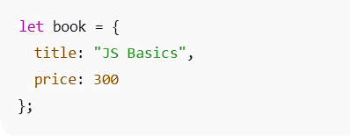
Object Literal Syntax
Simplest way to create objects
Easy to read and write
Mostly used in programs
Example:

Slide 14

Dot Notation
Most commonly used method
Simple and readable
Cannot be used for dynamic keys
Example:

Slide 15

Bracket Notation
Used when property name is dynamic
Works with variables
Also used when key has spaces
Example:

Slide 16

Dot vs Bracket Notation
Dot notation is faster and simpler
Bracket notation is flexible
Bracket is required for dynamic properties
Example:

Slide 17

Dynamic Property Names
Property names decided at runtime
Very useful in forms and APIs
Adds flexibility to objects
Example:

Slide 18

Object Manipulation
Add new properties
Update existing properties
Delete unwanted properties
Example:

Slide 19
Conclusion
Arrays manage lists of data
Array methods simplify data handling
Objects store structured information
Proper use improves code quality

